Slide 1
Car rental system
Members :
1)
2)
3)

Slide 2
Case study
Consider a scenario where you need to model different cars in a car rental system. You have a base class Car with a virtual function displaySpecs(), which displays the car's specifications. Implement two derived classes NormalCar and LuxuryCar, each representing a specific type of car. Override the displaySpecs() function in each derived class to provide the appropriate display behavior for the respective car type. Additionally, implement a Rent class that has a Car object as a member variable and demonstrates the usage of function overriding by calling the displaySpecs() function on the Car object. Finally, create objects of each car type and call the displaySpecs() function to demonstrate the usage of function overriding.

Slide 3
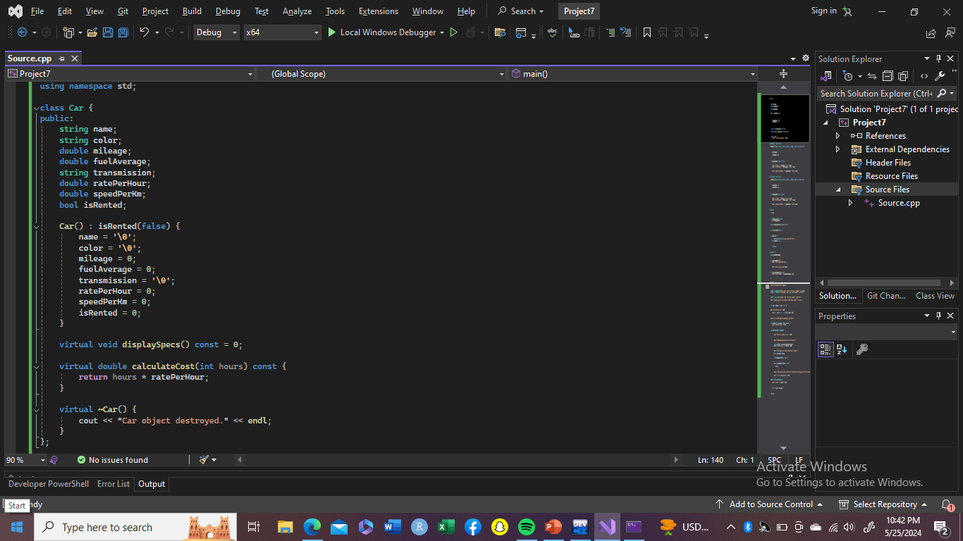
Car.cpp

Slide 4
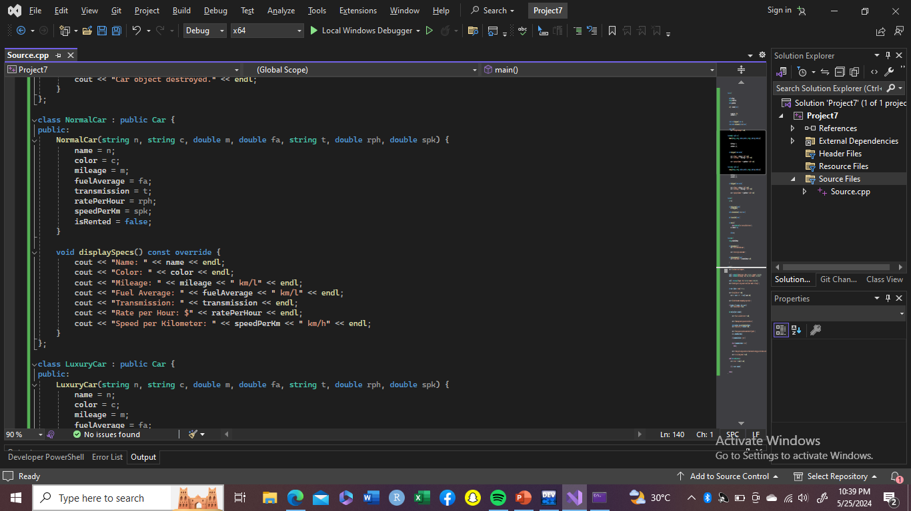
NormalCar.cpp

Slide 5
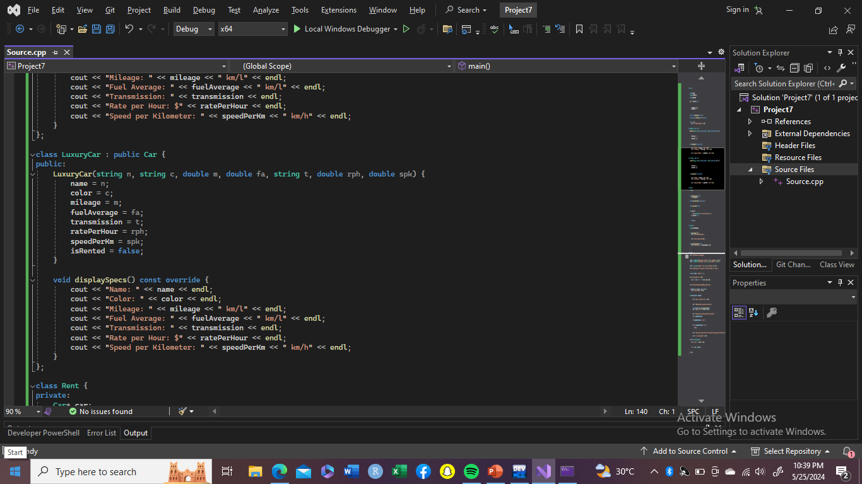
LuxuryCar.cpp

Slide 6
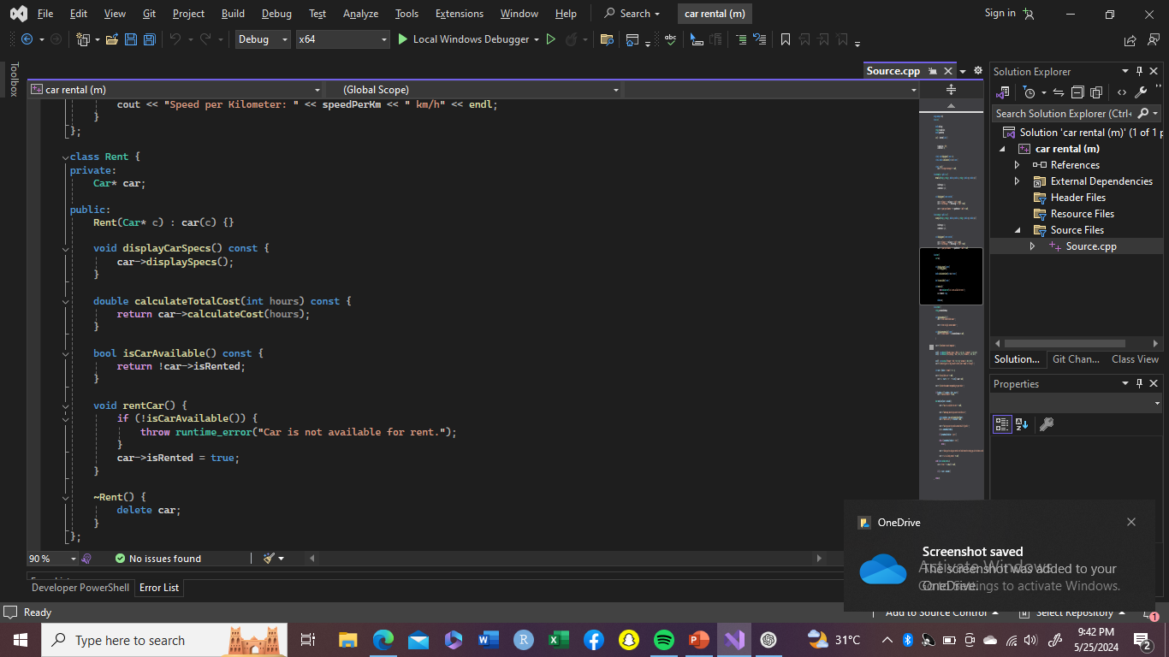
Rent.cpp

Slide 7
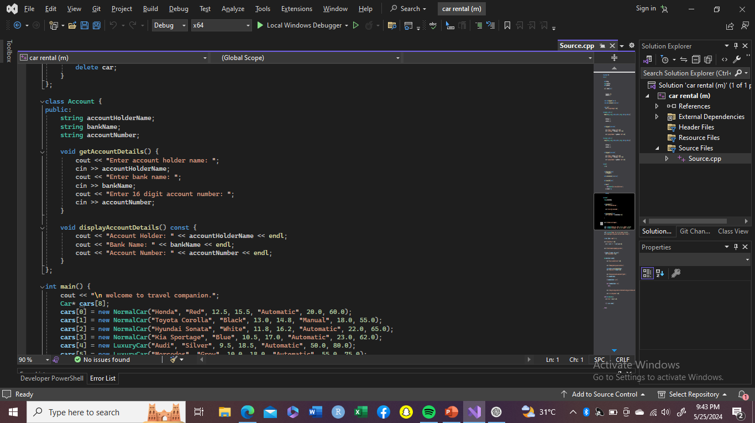
Account.cpp

Slide 8
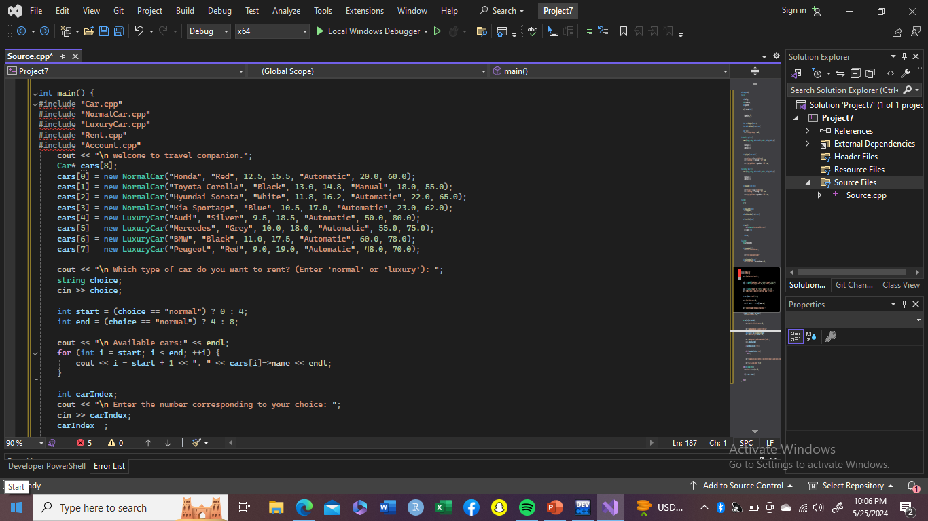
Main.cpp

Slide 9
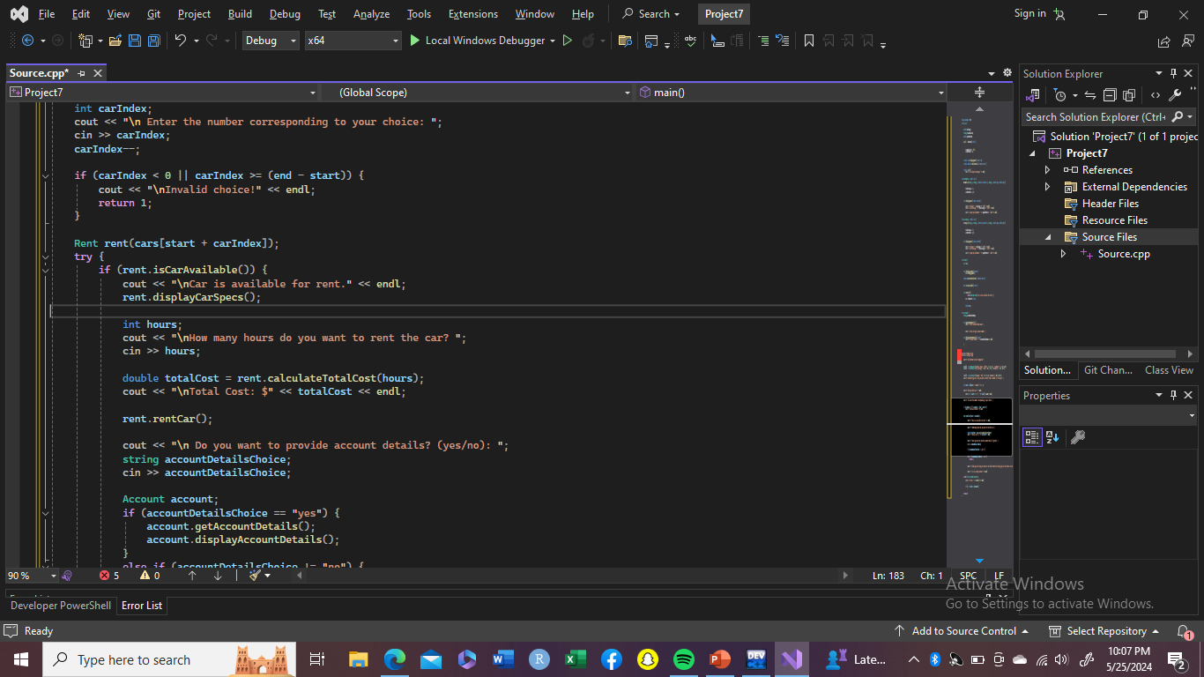
Main.cpp(continue)

Slide 10
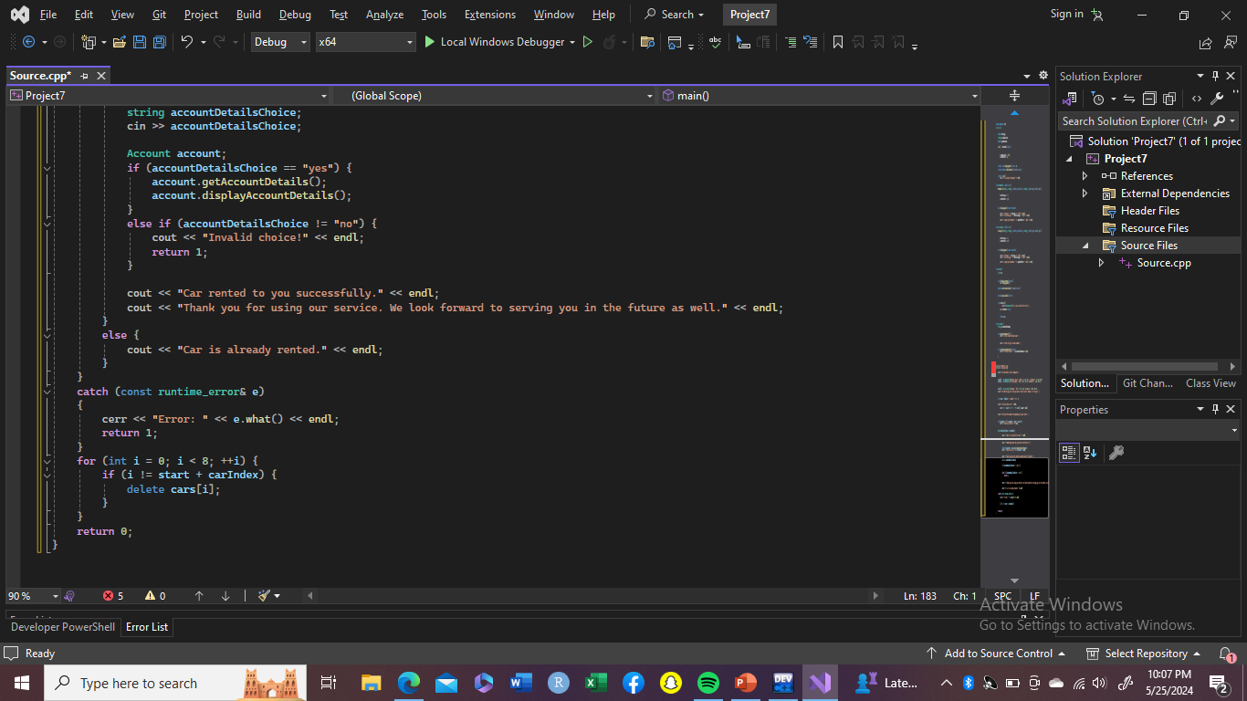
Main.cpp(continue)

Slide 11
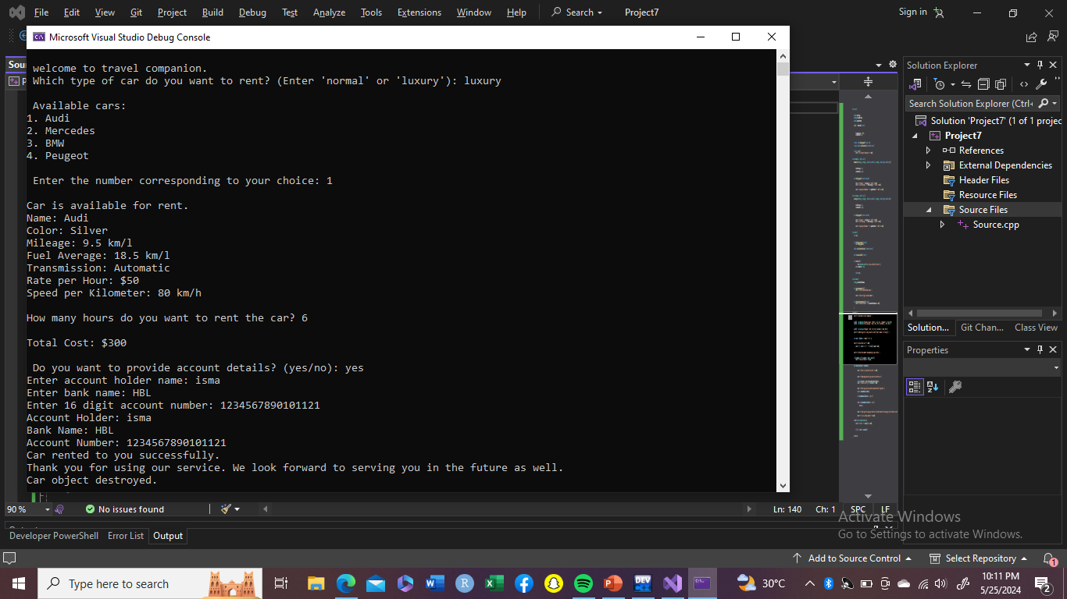
output

Slide 12
Main features
A base class Car with attributes like name, color, mileage, fuel average, transmission, rate per hour, speed per kilometer, and a boolean flag for rental status.
Two derived classes, NormalCar and LuxuryCar, which inherit from the Car class.
A Rent class that represents a car rental, including methods to display car specifications, calculate the total cost of rental, check availability, and rent a car.
An Account class to store and display account details.
In the main() function, an array of 8 cars (4 normal and 4 luxury) is created, and the user is prompted to choose a car type, select a car, rent it, and optionally provide account details.
Error handling is implemented using a try-catch block to handle runtime errors.
Finally, the program deletes the car objects and terminates.

Slide 13
Main cencepts used:
Inheritence
Abstraction
Encapsulation
Constructor
Destructor
Virtual function (polymorphism)
Polymorphism (override)
Dynamic memory allocation/deallocation
Exception handling

